Slide 1


Introduction to Programming Using Python Programming
Instructor :- Arka Patra

Slide 2

What Is Python ???
Multi-purpose (Web GUI, Scripting)
Object Oriented
Interpreted
Loosely Typed as well as Dynamically Typed
Focus on productivity and readability

Slide 3
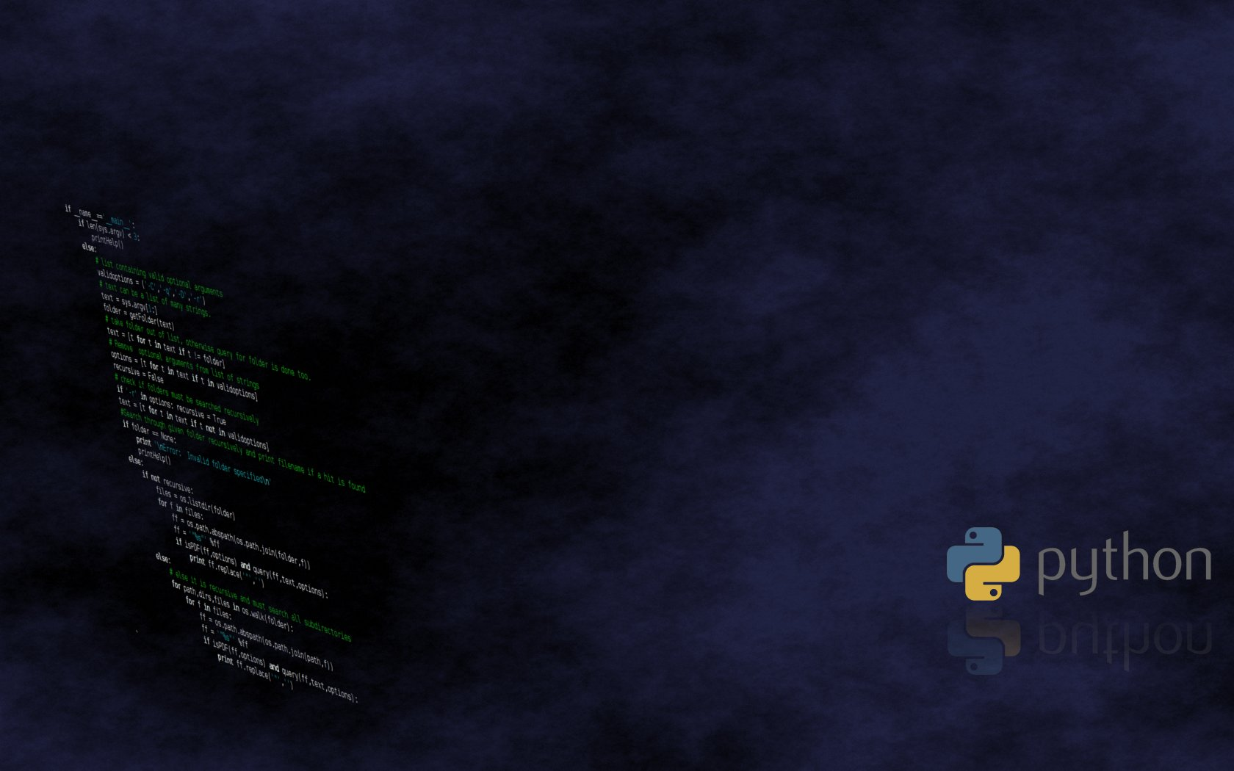
Who uses Python ???
Google
PBS
NASA
Library of Congress
ONION
And several others

Slide 4
Syntax of Python
The syntax for Python is as simple as this shown below :-
print “Hello World!!!”

Slide 5
Indentation in Python
Most languages doesn’t care about indentation
It tends to group similar elements and statements inside a specific function block. Care about the codes being written should be in proper indentation, and if not then might cause an error or might cause wrong output.

Slide 6
Data-Types in Python
→ Strings
→ Numbers
→ NULL
→ Lists
→ Tuples
→ Dictionary

Slide 7
Strings in Python
Strings are basically array of characters which terminates with a special character known as “NULL Character”.
Generally quoted inside single or double inverted quotes.

Slide 8
Numbers in Python
Numbers are same as we have come across integer types in other programming languages.
In Python there is no other classification of integer basically there is no existence of float, double like this. It is initialized in a variable like:-
variable=8
variable=8.0002

Slide 9
NULL in Python
Null is a fictitious type of data where there is no existence of data in real. This declared like:-
List=[ ]

Slide 10
LIST in Python
The list is a most versatile datatype available in Python which can be written as a list of comma-separated values (items) between square brackets. Important thing about a list is that items in a list need not be of the same type

Slide 11
TUPLES in Python
A tuple is a sequence of immutable Python objects. Tuples are sequences, just like lists. The differences between tuples and lists are, the tuples cannot be changed unlike lists and tuples use parentheses, whereas lists use square brackets.

Slide 12
Dictionary in Python
A dictionary is a kind of mutable datatype similar to list but there is no existence of index in dictionaries but the term index is replaced by keys and for each keys there is unique values.
Dictionaries are example of hashed tables.

Slide 13
Operators in Python
Arithmetic
Logical
Identity
Assignment

Slide 14
Loops in Python
For loop
Expanded For loop
While loop

Slide 15
For loop in Python
It is completely different from those syntax we have encountered in C or C++.
The Syntax for “FOR” loop is as shown below :-
for variable in range(Upper limit)

Slide 16
Expanded For loop in Python
for variable in List :
print value of x
As far as there is valid value in lists the value will be passed on to x.

Slide 17
While loop in Python
while condition:
statements
condition increment or decrement

Slide 18
Decision Making Statements in Python
Decision Making statements are related to making and adding statements according to the decision taken by the user by understanding the problem. The statements are :-
if a<b:
statement 1
elif b>a:
statement 2
else :
statement 3

Slide 19
Break & Continue Statement loop in Python
A break statement results in the termination of the statement to which it applies ( switch , for , do , or while ). A continue statement is used to end the current loop iteration and return control to the loop statement.

Slide 20
Break Statement Execution Flow
Loop 1 :
loop 2:
statement1
break
After execution of break statement it moves out of the loop 2 and straight away moves to Loop 1.

Slide 21
Continue Statement Execution Flow
Loop 1 :
statement1
continue
loop 2:
After the execution of continue statement it proceeds to next loop or statement basically acts as a pass to where it is applied.

Slide 22
Local & Global Variables in Python
Variables play one of the most important role in all programming language. Basically a variable can be categorized into two types :-
Local Variable
Global Variable

Slide 23
Local Variables in Python
Local Variable is defined inside a function whose scope is limited throughout the program. Its value is retained inside the function only but can be accessed by the program at any point of time.

Slide 24
Global Variables in Python
Global Variables are defined outside the function and its scope is valid throughout the program and its value is not only retained in the function where used but also outside the program and can be easily accessed by the program at any point of time.

Slide 25
Taking input in Python
For Python 2.7.14 – input is taken by raw_input() function.
For Python 3.6.4 – input is taken by input() function.
Raw_input() has been changed to input() in python 3.6.4
Syntax:-
A=raw_input(“Enter the input”)
A=input(“Enter the input”)

Slide 26
Functions in Python
Functions are used to utilize code in more than one place in a program. The only way without functions to reuse code consists in copying the code. A function in Python is defined by a def statement. Syntax goes like this :-
def function_name(parameter):
statement 1
statement 2

Slide 27
Functions in Python(Contd.)
Parameter passed in the function on which the operation will take place
def function_name(parameter):
statement 1
statement 2
# Function calling
function_name(parameter)
Def is used to define the function
Function name as given by the user
Function calling or invocation of the function

Slide 28
Lambda in Python
The lambda operator or lambda function is a way to create small anonymous functions, i.e. functions without a name. These functions are throw-away functions, i.e. they are just needed where they have been created. Lambda functions are mainly used in combination with the functions filter(), map() and reduce().

Slide 29
Map Function in Python
The map function is the simplest one among Python built-ins used for functional programming. These tools apply functions to sequences and other iterables. The filter filters out items based on a test function which is a filter and apply functions to pairs of item and running result which is reduce.

Slide 30
Filter Function in Python
The filter() function in Python takes in a function and a list as arguments. This offers an elegant way to filter out all the elements of a sequence “sequence”, for which the function returns True.

Slide 31
Reduce Function in Python
The reduce(fun,seq) function is used to apply a particular function passed in its argument to all of the list elements mentioned in the sequence passed along. This function is defined in “functools” module. reduce() can also be combined with operator functions to achieve the similar functionality as with lambda functions and makes the code more readable.

Slide 32
File Handling in Python
File handling is same as what we came across in other programming languages. There are few ways in which we handle the files. Let’s get acquainted with file handling modes first.

Slide 33
File Handling Modes in Python
Sr.No. | Modes & Description
1 | r Opens a file for reading only. The file pointer is placed at the beginning of the file. This is the default mode.
2 | rb Opens a file for reading only in binary format. The file pointer is placed at the beginning of the file. This is the default mode.
3 | r+ Opens a file for both reading and writing. The file pointer placed at the beginning of the file.
4 | rb+ Opens a file for both reading and writing in binary format. The file pointer placed at the beginning of the file.
5 | w Opens a file for writing only. Overwrites the file if the file exists. If the file does not exist, creates a new file for writing.

Slide 34
File Handling Modes in Python
Sr.No. | Modes & Description
6 | wb Opens a file for writing only in binary format. Overwrites the file if the file exists. If the file does not exist, creates a new file for writing.
7 | w+ Opens a file for both writing and reading. Overwrites the existing file if the file exists. If the file does not exist, creates a new file for reading and writing.
8 | wb+ Opens a file for both writing and reading in binary format. Overwrites the existing file if the file exists. If the file does not exist, creates a new file for reading and writing.
9 | a Opens a file for appending. The file pointer is at the end of the file if the file exists. That is, the file is in the append mode. If the file does not exist, it creates a new file for writing.
10 | ab Opens a file for appending in binary format. The file pointer is at the end of the file if the file exists. That is, the file is in the append mode. If the file does not exist, it creates a new file for writing.

Slide 35
File Handling Modes in Python
11 | a+ Opens a file for both appending and reading. The file pointer is at the end of the file if the file exists. The file opens in the append mode. If the file does not exist, it creates a new file for reading and writing.
12 | ab+ Opens a file for both appending and reading in binary format. The file pointer is at the end of the file if the file exists. The file opens in the append mode. If the file does not exist, it creates a new file for reading and writing.

Slide 36
File Object Attributes in Python
Once a file is opened and you have one file object, you can get various information related to that file.
Sr.No | Attribute & Description
1 | file.closed Returns true if file is closed, false otherwise.
2 | file.mode Returns access mode with which file was opened.
3 | file.name Returns name of the file.
4 | file.softspace Returns false if space explicitly required with print, true otherwise.

Slide 37
Opening a File in Python
Opening a file in python is executed by open() function. An object of the file is created and using the file object the file is opened. The syntax for opening a file is as follows :-
File_object = open(“file_name", “handling mode")

Slide 38
Reading a File in Python
Reading a file is done using open() function but the mode of handling of the file is changed over here. There are two ways in which the file can be read :-
WAY 1
file = open('sample.txt', 'r’)
# This will print every line one by one in the file
for each in file:
print (each)
WAY 2
file = open(“sample.text”, “r”)
print file.read()
This directly reads the content of the file.

Slide 39
Deleting a File in Python
You can use the remove() method to delete files by supplying the name of the file to be deleted as the argument.
Import os
# now the command to execute the delete operation
Os.remove(“sample.txt”)
#As soon as the command is executed the file sample.txt deleted.

Slide 40
Tkinter in Python (GUI)
Tkinter is the standard GUI library for Python. Python when combined with Tkinter
provides a fast and easy way to create GUI applications. Tkinter provides a powerful
object-oriented interface to the Tk GUI toolkit.
Creating a GUI application using Tkinter is an easy task. All you need to do is perform
the following steps:
• Import the Tkinter module.
• Create the GUI application main window.
• Add one or more of the above-mentioned widgets to the GUI application.
• Enter the main event loop to take action against each event triggered by the
user.

Slide 41
Tkinter Widgets in Python
Operator Description
Button The Button widget is used to display buttons in your application.
Canvas
The Canvas widget is used to draw shapes, such as lines, ovals,
polygons and rectangles, in your application.
Checkbutton
The Checkbutton widget is used to display a number of options as
checkboxes. The user can select multiple options at a time.
Entry
The Entry widget is used to display a single-line text field for
accepting values from a user.

Slide 42
Tkinter Widgets in Python
Frame
The Frame widget is used as a container widget to organize other
widgets.
Label
The Label widget is used to provide a single-line caption for other
widgets. It can also contain images.
Listbox The Listbox widget is used to provide a list of options to a user.
Menubutton
The Menubutton widget is used to display menus in your
application.
Menu
The Menu widget is used to provide various commands to a user.
These commands are contained inside Menubutton.
Message
The Message widget is used to display multiline text fields for
accepting values from a user.

